Slide 1
Magneto-Aerotaxis
Like other free-swimming bacteria, magnetotactic bacteria propel themselves through the water by rotating their helical flagella.
Because of their magnetosomes, magnetotactic bacteria are passively oriented and actively migrate along the local magnetic field B, which in natural environments is the geomagnetic field.
When distinct morphotypes of magnetotactic bacteria, isolated and grown in pure culture, were studied in oxygen concentration gradients using thin, flattened capillaries (Vitrocom, Inc.), it became clear that magnetotaxis and aerotaxis work together in these bacteria
The behavior observed in these strains referred to as “magneto-aerotaxis”, and two different magneto-aerotactic mechanisms – termed polar and axial – are found in different bacterial species.

Slide 2
Magneto-Aerotaxis
For both polar and axial magnetotactic bacteria, the cellular magnetic dipole remains oriented along the local magnetic field, but direction of migration along magnetic field lines is determined by sense of flagellar rotation, which in turn is controlled by aerotactic receptors.
Magnetotactic bacterium is essentially a self-propelled magnetic dipole with an oxygen sensor.
Magnetotaxis effectively turns a three dimensional search problem to find the optimal oxygen concentration into a one-dimensional search problem by using the magnetic field.

Slide 3
Magnetite Crystals in Magnetosomes
HR-TEM, selected-area electron-diffraction studies, and electron holography revealed that magnetite crystals within magnetotactic bacteria are of high structural perfection and have been used to determine their idealized morphologies
The morphologies are all derived from combinations of {111}, {110}, and {100} forms (a form refers to the equivalent symmetry related lattice planes of the crystal structure) with some distortions
These include cuboctahedral ([100] + [111]), and elongated, non equidimensional prismatic
The cuboctahedral crystal morphology preserves symmetry of face-centered cubic spinel structure that is, all symmetry-related crystal faces are equally developed.
In the elongated and prismatic morphologies, some symmetry-related faces are unequally developed.
This implies anisotropic growth conditions, for example, an anisotropic ion flux into the magnetosome membrane.
It is thought that magnetite forms from a precursor, an amorphous iron oxide phase

Slide 5
Greigite Crystals in Magnetosomes
All freshwater, magnetotactic bacteria have been found to synthesize magnetite magnetosomes, many marine, estuarine, and salt-marsh species produce iron sulfide magnetosomes consisting primarily of the magnetic iron sulfide, greigite (Fe₃S₄)
While none of these organisms is currently available in pure culture
Recognized greigite-producing magnetotactic bacteria include a multicellular, magnetotactic prokaryote and a variety of relatively large, rod-shaped bacteria.
The greigite crystals in their magnetosomes are thought to form from nonmagnetic precursors including mackinawite (tetragonal FeS) and possibly a sphalerite-type cubic FeS
Morphologies of the greigite crystals also appear to be species and or strain-specific
There is one reported instance of a marine bacterium that contains magnetite and greigite magnetosomes co-organized within the same magnetosome chain

Slide 6
Biochemistry and Gene Expression in Magnetosome Formation
Knowledge of the biochemical and genetic controls on magnetite production is essential to understanding how the magnetotactic bacteria produce magnetosomes and organize them in chains.
Although progress has been made by several laboratories, and the genomes of two magnetotactic bacteria (M. magnetotacticum and strain MC-1) have been sequenced, the overall process is not well understood and is a focal point for future work.
Magnetosome mineral formation must begin with transport of Fe into the cell and deposition within the MM vesicles to form a saturated Fe solution
Manipulation of the redox conditions within the MM vesicles so that [Fe(III)]/[Fe(II)] was ~ 2, corresponding to a redox potential of about –100 mV at elevated pH, would make magnetite the most stable Fe-oxide phase
The MM could also provide sites for nucleation and growth of the magnetite crystals.
Interactions of the MM with the faces of the growing crystal could affect crystal morphology

Slide 8
Biochemistry of Magnetosome Formation
Schüler and Baeuerlein found that initially Fe-starved cells became magnetic (i. e., formed magnetosomes) within ~ 10 minutes after incubation in 10 mM Fe(III).
Since Fe can amount to 2–3% of the dry weight of a magnetotactic bacterium, an efficient Fe uptake system is required.
An important question in the magnetite synthesis process concerns whether Fe(III) or Fe(II) is transported into magnetosome membrane vesicles.
Cells of Magnetospirillum gryphiswaldense mainly take up Fe(III) via a high-affinity system
Magnetotactic bacterial cells have Fe(III) reductase activity, and a Fe(III) reductase has been isolated from M. magnetotacticum.
Fe(III) reductase appears to be cytoplasmic, it may be bound on the inner side of the cytoplasmic membrane and could participate in the reduction of Fe(III) as it enters the cell

Slide 9
Gene Expression in Magnetosome Formation
Since the MM is thought to be of paramount importance in magnetosome mineral formation, researchers have focused on the role MM proteins – that is, proteins which occur in the magnetosome membrane, in magnetosome synthesis
Two different approaches have been used:
N-terminal amino acid sequencing of the MM proteins, followed by “reverse genetics” to obtain gene sequences for these proteins
Performing biochemical protein comparison of mutants that do not produce magnetosomes with wild-type strains, then again using “reverse genetics” to determine gene sequences

Slide 10
Gene Expression in Magnetosome Formation
Organism | Gene | Function/homology to existing proteins
M. gryphiswaldense and M. magnetotacticum | MamA | tetratricopeptide repeat proteins
 | MamB | cation diffusion facilitators
 | MamE | HtrA-like serine proteases
M. magneticum strain AMB-1 | MagA | proton-gradient-driving H/Fe(II) antiporter
Magnetospirillum strain AMB-1 and M. magnetotacticum | mms6 | acyl-CoA transferase
 | mms16 | GTPase activity, also involved in MM vesicle formation by invagination and budding from the cytoplasmic membrane
 | mpsA | the most abundant of the three, is apparently bound to magnetite and may function in regulation of crystal growth

Slide 11
Applications of Magnetosomes
Magnetosomes have been exploited in a number of applications
Commercial applications include
Immobilization of enzymes for use in biosensors,
Formation of magnetic antibodies in various fluoro immunoassays
quantification of IgG
Detection and separation of various cell types
Transfer of genes into cells.
Magnetosomes also show promise as MRI contrast enhancement agents.
Whole magnetotactic bacteria have been used for cell separations, as oxygen biosensors, and in studies of magnetic domains in meteorites and terrestrial rocks.

Slide 12
Research Methods
Research on magnetosomes in magnetotactic bacteria primarily involves conventional, well-known, microbiological and molecular biological methods.
Details on culturing magnetotactic bacteria,
Extracting magnetosomes
Analyzing MM proteins and genes

Slide 13
Conclusion
Magnetotactic bacteria have solved the problem of constructing an internal, permanent, magnetic dipole that is sufficiently robust so that a cell will be aligned along the geomagnetic field as it swims, yet be no longer than the length of the cell (ca. 1–2 mm).
The solution involves a hierarchical structure – the magnetosome chain – and a mineralization process in which the mineral type, grain size and placement in the cell are all controlled by the cell.
Primary control is presumably exerted by the magnetosome membrane through MM proteins.
The roles of the MM proteins and the details of the magnetosome mineralization process are the most important issues to be elucidated.

Slide 14
Future Research Directions
Directions for future research include the development of genetic systems in order to move genes in and out of magnetotactic bacteria, and to prepare knock-out mutants of strains in order to determine the functions of the MM proteins in magnetosome mineralization.
It would be useful to develop convenient assays for the MM proteins.
It would also be useful to develop methods for determining the mineral intermediates of magnetite and greigite mineralization and quantifying them over time.
Methods need to be devised for culturing bacteria with greigite magnetosomes, in order to compare the biomineralization processes for greigite and magnetite.

Slide 15
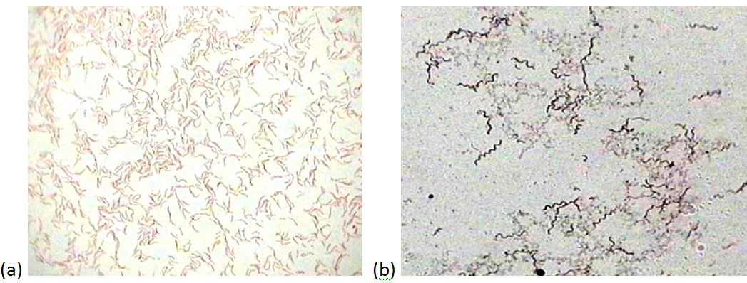
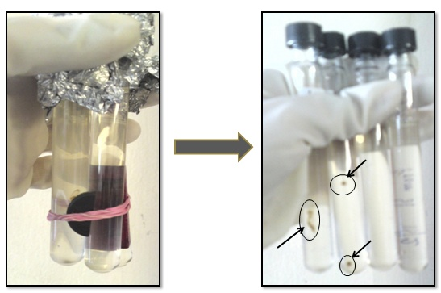
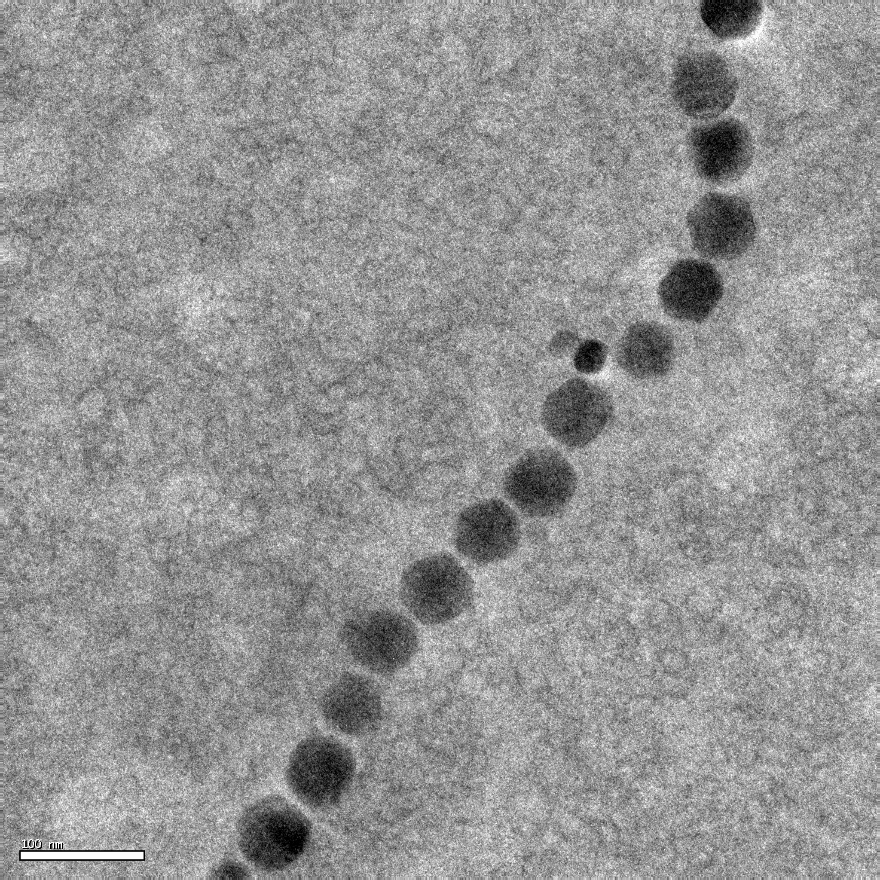
Magnetotactic bacteria (Magnetospirillum gryphiswaldenes) for production of bionano magnets
50nm
100nm
MTB culture grown in HS medium (ii) Gram staining (a) Shorter and wider after culture revival (b) Longer and slender bacteria after repeated culturing (c) Response to magnet (d) HR-TEM of magnetasomes

Slide 16
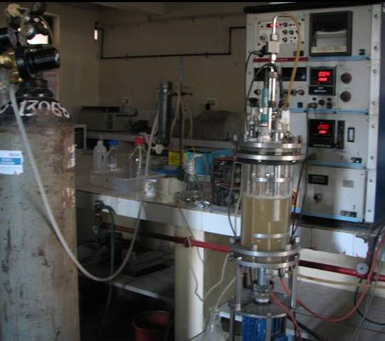
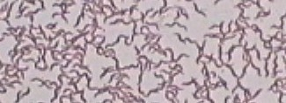
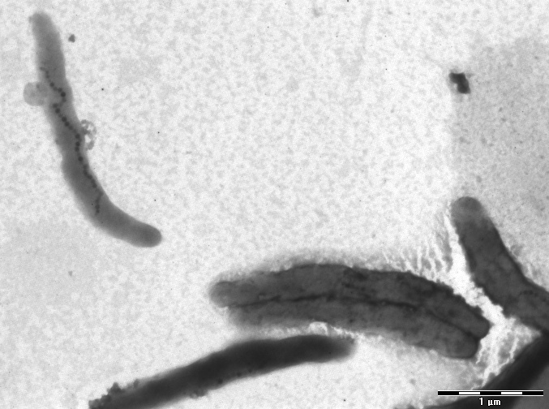
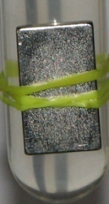
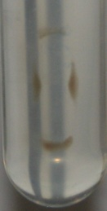
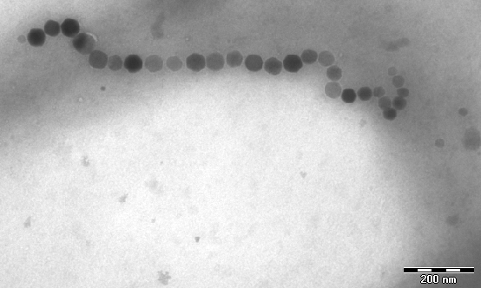
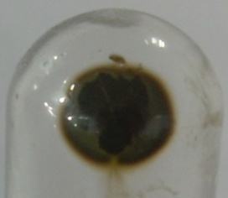
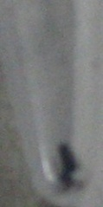
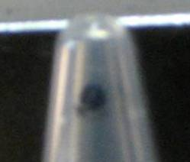
Growth and characterization of M. gryphiswaldense and magnetosome formation
b
5µm
d
c
1µm
e
200nm
f
g
h
a
a- Cultivation of MB in 3 L fermentor. b and c – Morphological and magnetic characterization of MB, d – TEM image of MB, f – cell pellet of Magnetic MB, g – lysed inorganic Fe3O4 crystals, h Response to extrernal magnetic field

Slide 17
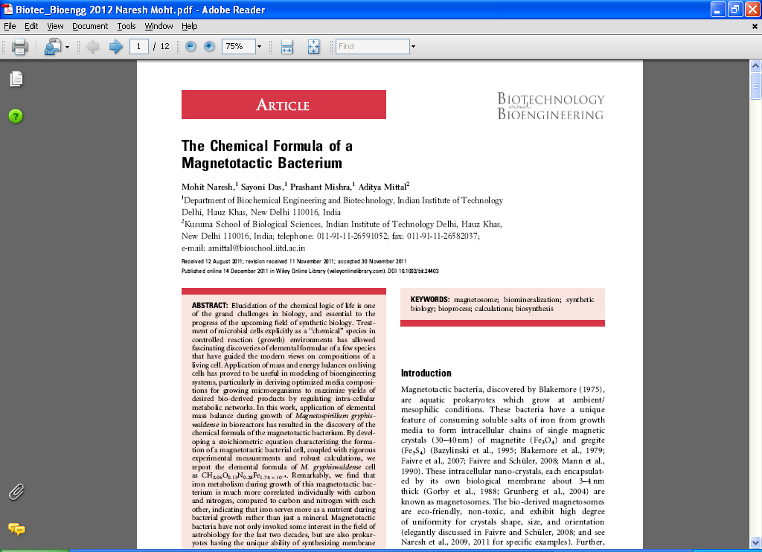

Slide 18
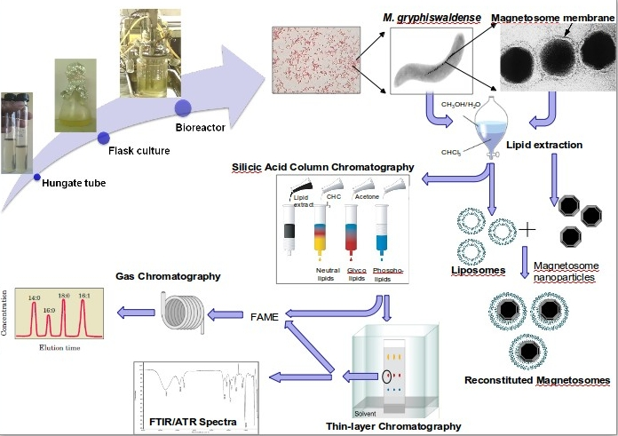
Notes:
18
18
18
18

Slide 19
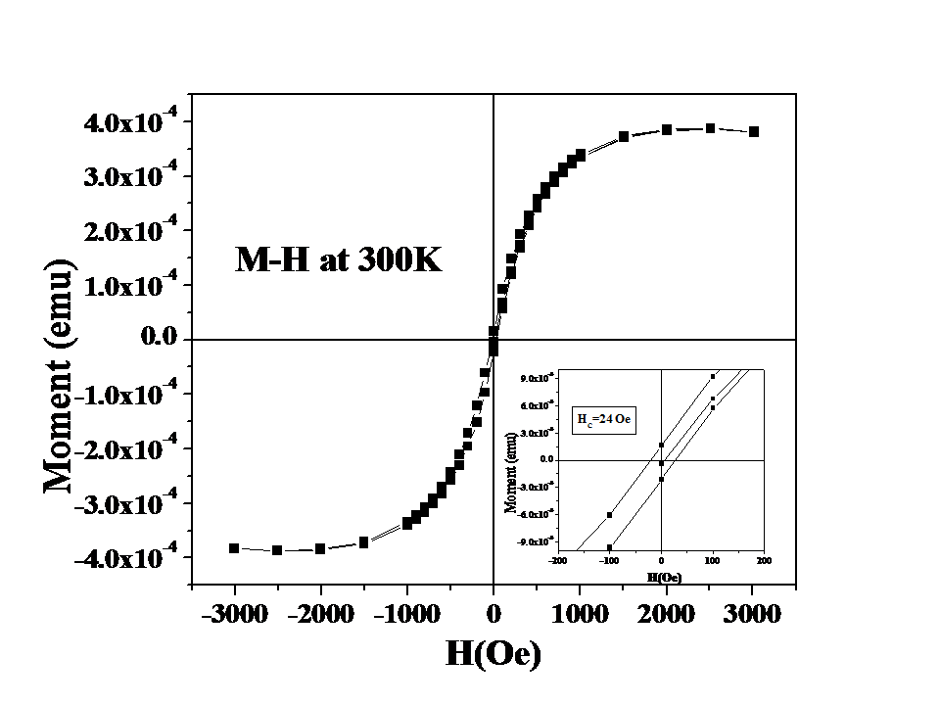
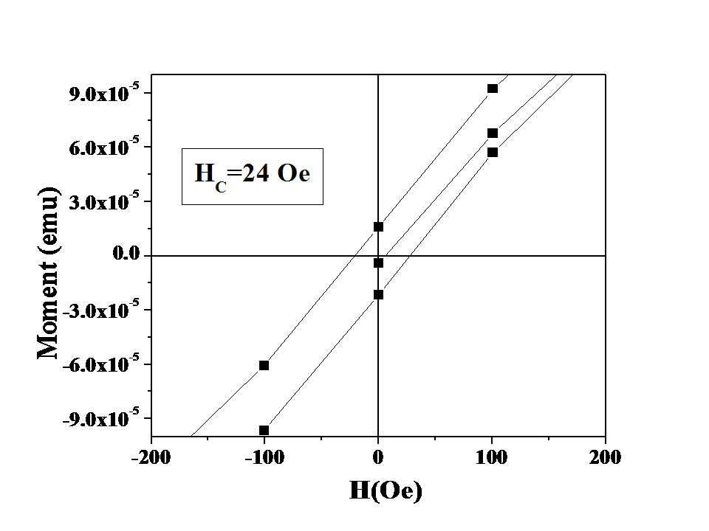
Squid (Super conducting quantum interference device) Measurements M-H curve of Bacterial sample grown in the absence of Mn (Ferric Citrate)
Coercivity is a measure of the ability of a ferromagnetic material to withstand an external magnetic field without becoming demagnetized.
Coercivity (H_{C}) Intensity of applied magnetic field required to reduce magnetization to zero

Slide 20
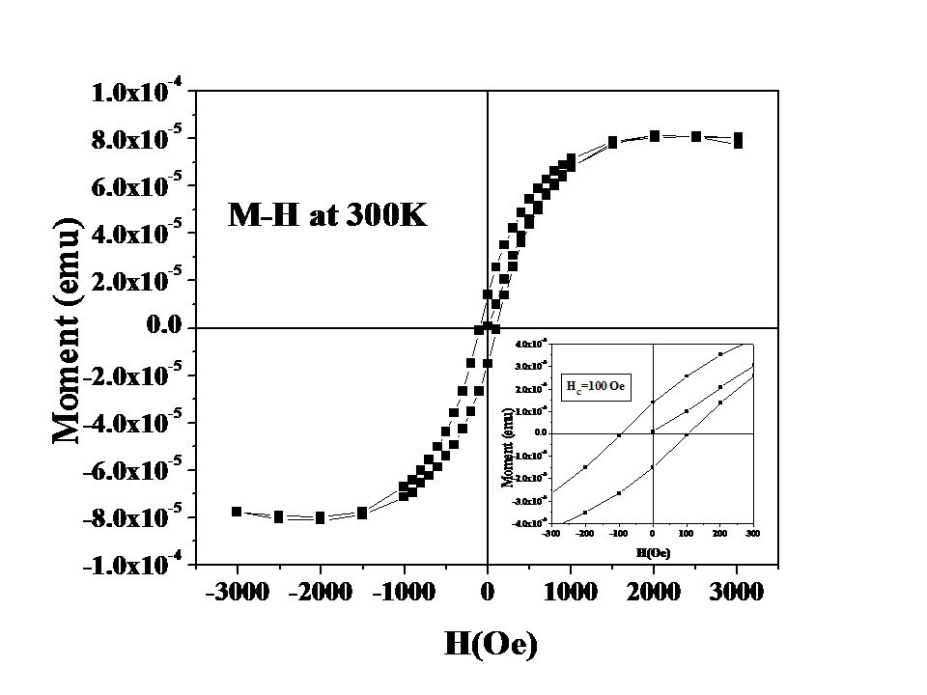
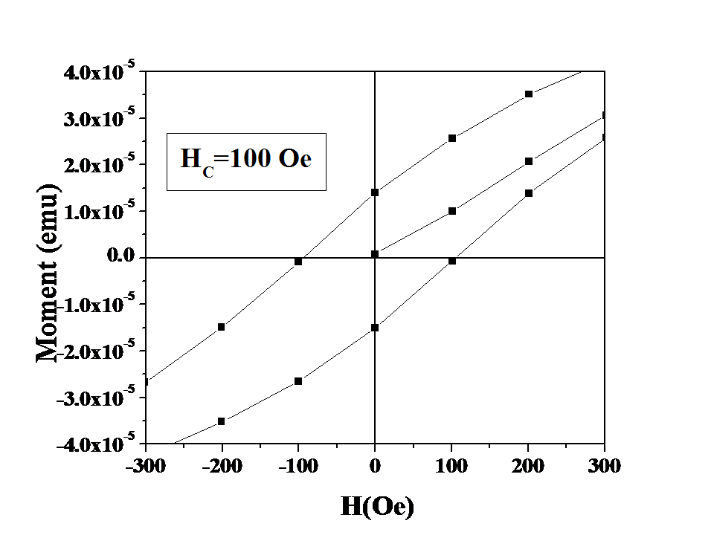
Squid Measurement M-H curve of Bacterial sample grown in the presence of Mn (MnCl₂)

